Slide 1
Doc 4.2(9) – Improving Climate Observations
The 19th World Meteorological Congress
Peter Thorne Acting Chair Steering Committee of GCOS, AOPC Chair 24 May 2023

Slide 2
Producing GCOS Implementation Plan
GCOS has a 5 year cycle of monitoring the climate observing system → GCOS Status Reports → GCOS Implementation Plans based on extensive consultation and public review
GCOS Status Report
2021
Consultations
GCOS expert Panels get inputs from their communities
COP27
Adopts a decision welcoming GCOS IP
Preparation of supplements for specific communities.
Drafting
Led by a writing team
Panels identify main actions needed in next 5-10 years
2022 GCOS Implementation Plan
2022 GCOS Implementation Plan
2021 GCOS Status report
GCOS monitors performance of global climate observing system
2016 GCOS Implementation Plan
Publication
Published by GCOS
Submitted to Sponsors and UNFCCC
Revision
comments addressed
final checks by GCOS experts
Review
Broad public review (400 comments)
Earlier Status Reports and plans
 | 2

Slide 3
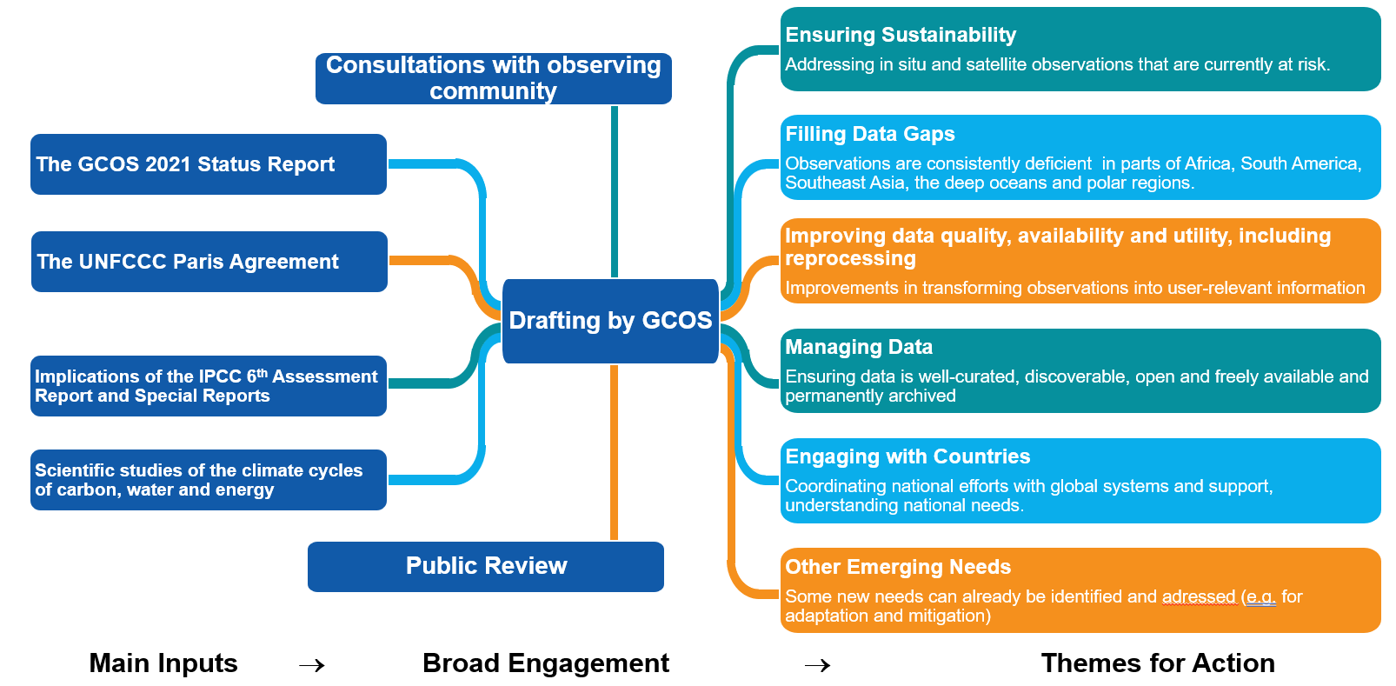
2022 GCOS Implementation Plan
 | 3

Slide 4
WMO/NMHS Annex
B: FILLING DATA GAPS
B1. Development of reference networks (in-situ and satellite Fiducial Reference Measurement (FRM) programs)
B2. Development and implementation of the Global Basic Observing Network (GBON)
B4. Expand surface and in situ monitoring of trace gas composition and aerosol properties
B5. Implementing global hydrological networks
B6. Expand and build a fully integrated global ocean observing system
B8. Coordinate observations and data product development for ocean CO2 and N2O
B9. Improve estimates of latent and sensible heat fluxes and wind stress
C: IMPROVING DATA QUALITY, AVAILABILITY AND UTILITY, INCLUDING REPROCESSING
C1. Develop monitoring standards, guidance and best practices for each ECV
C3. General Improvements to in-situ data products for all ECVs
A: ENSURING SUSTAINABILITY
Ensure necessary levels of long-term funding support for in-situ networks, from observations to data delivery
D: MANAGING DATA
D1. Define governance and requirements for Global Climate Data Centres
D2. Ensure Global Data Centres exist for all in situ observations of ECVs
D4. Create a facility to access co-located in-situ cal/val observations and satellite data for quality assurance of satellite products
D5. Undertake additional in situ data rescue activities
F: OTHER EMERGING NEEDS
F1. Responding to user needs for higher resolution, real time data
F3. Improve monitoring of coastal and Exclusive Economic Zones
F4. Improve climate monitoring of urban areas
F5. Develop an Integrated Operational Global GHG Monitoring System
E: ENGAGING WITH COUNTRIES
E1. Foster regional engagement in GCOS
E2. Promote national engagement in GCOS
 | 4

Slide 5
Draft Resolution 4.2(9)/1 (Cg-19)
Improving Climate Observations
THE WORLD METEOROLOGICAL CONGRESS,
Endorses the conclusions of the 2022 GCOS Implementation Plan (GCOS-244) and the 2022 GCOS ECVs Requirements (GCOS-245);
Encourages Members to collaborate with national partners with the view to address the full set of actions provided in the 2022 GCOS Implementation Plan (GCOS-244);
Urges Members to take action to address the relevant actions provided in the Annex to this Resolution – WMO/NMHS Supplement to the 2022 GCOS Implementation Plan;
Requests the president of INFCOM to facilitate the implementation of the relevant actions provided in the annex to this Resolution – WMO/NMHS Supplement to the 2022 GCOS Implementation Plan;
Requests the Secretary-General to support Members in addressing the relevant actions provided in the annex to this Resolution – WMO/NMHS Supplement to the 2022 GCOS Implementation Plan;
Invites the other co-sponsors of GCOS, (the International Oceanographic Commission of UNESCO (IOC), the United Nations Environment Programme (UNEP), the International Science Council (ISC)) to continue to support the GCOS programme.
 | 5

Slide 6
Thank you
^{wmo.int}

